Slide 1
Data Structures: Hashing
Computer Science, Purdue University
Copyright WILEY, Goodrich and Tamassia, Data Structures And Algorithms

Slide 2
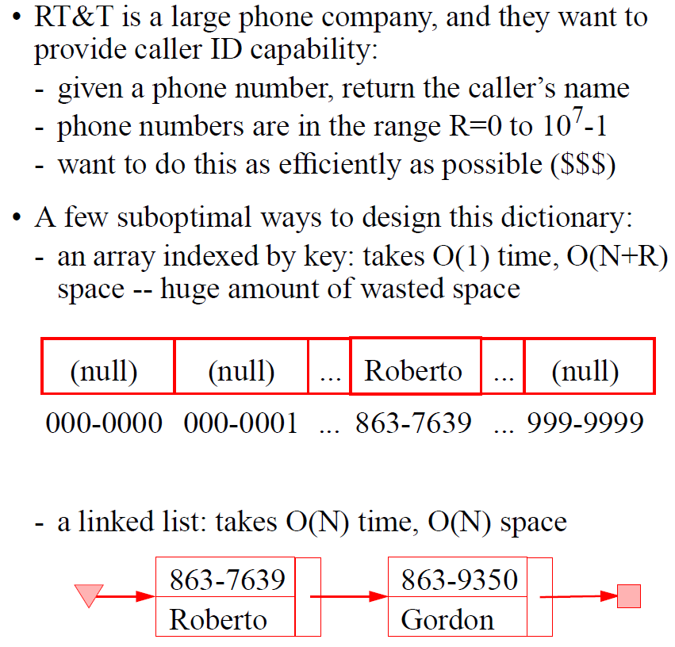
Hashing
Introduction
Computer Science, Purdue University

Slide 3
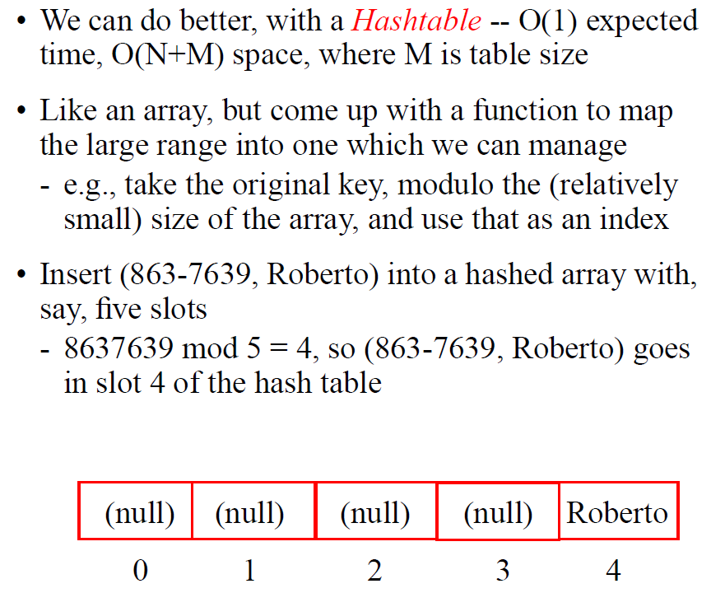
Hashing
Hash Tables
Computer Science, Purdue University

Slide 4
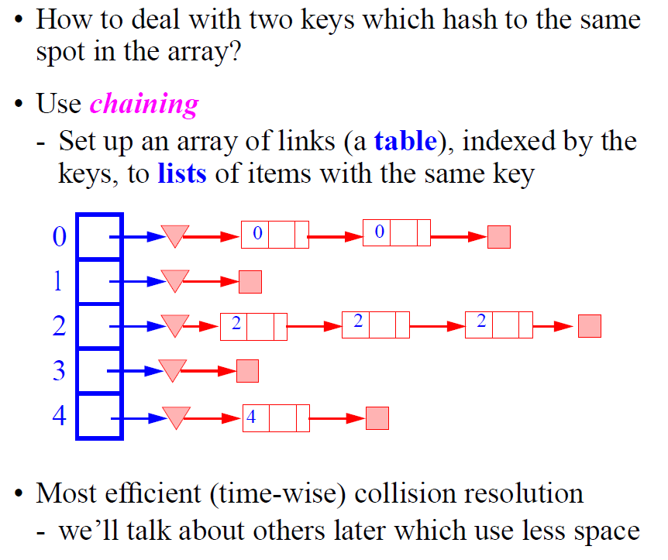
Hashing
Hash Tables: Collisions
Computer Science, Purdue University

Slide 5
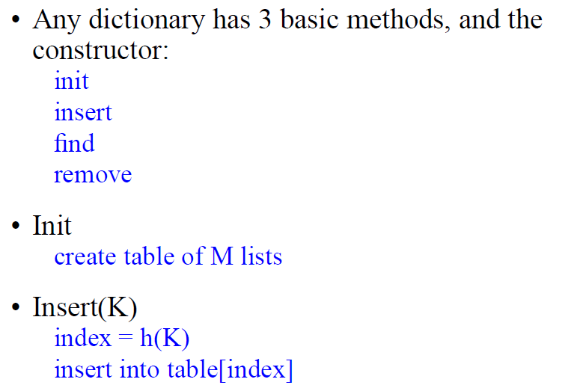
Hashing
Hash Tables: Pseudocode
Computer Science, Purdue University

Slide 6
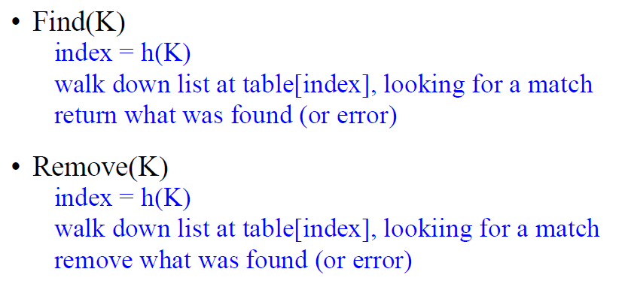
Hashing
Hash Tables: Pseudocode
Computer Science, Purdue University

Slide 7
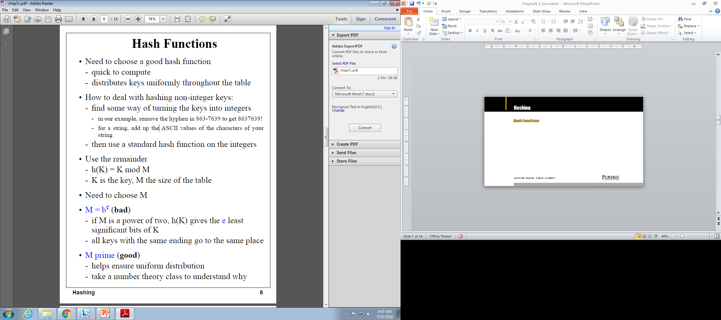
Hashing
Hash Functions
Computer Science, Purdue University

Slide 8
Hashing
Hash Functions
Computer Science, Purdue University

Slide 9
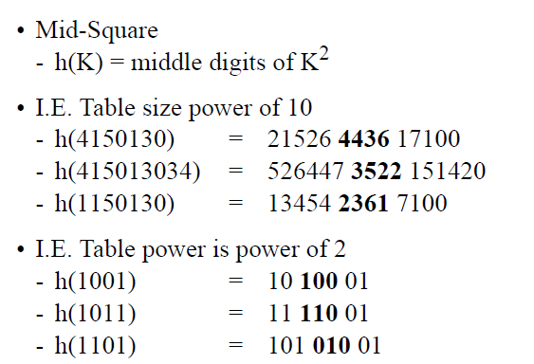
Hashing
Hash Functions
Computer Science, Purdue University

Slide 10
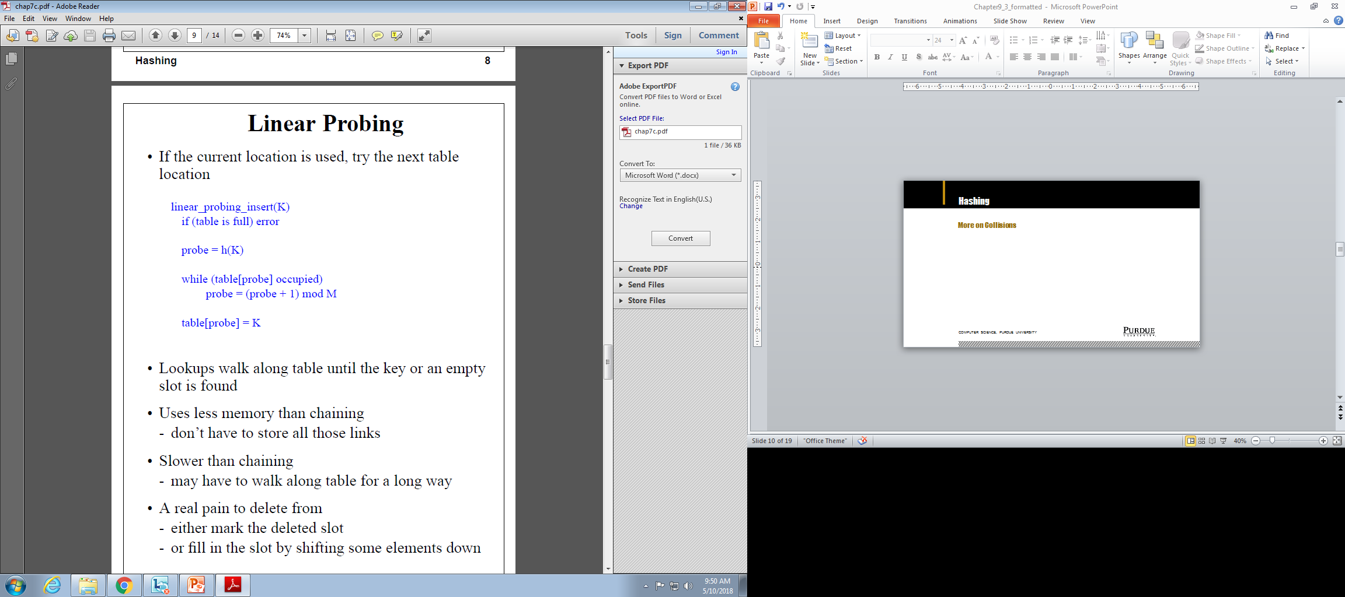
Hashing
More on Collisions
Computer Science, Purdue University

Slide 11
Hashing
More on Collisions
Computer Science, Purdue University

Slide 12
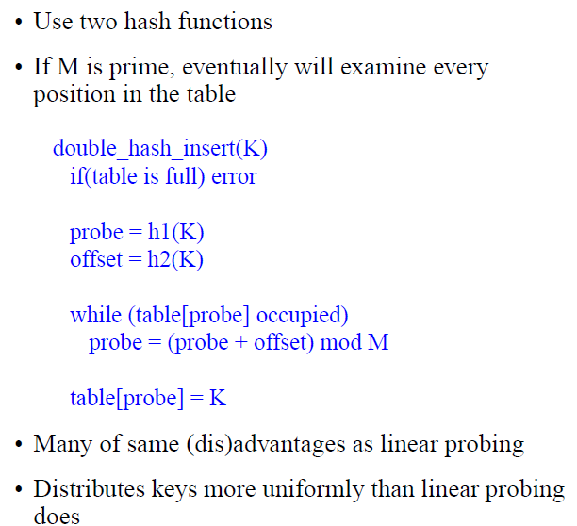
Hashing
More on Collisions
Computer Science, Purdue University

Slide 13
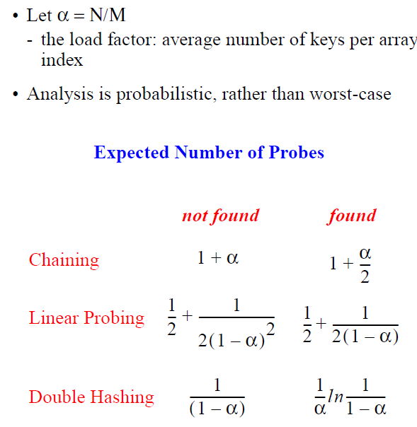
Hashing
Performance
Computer Science, Purdue University

Slide 14
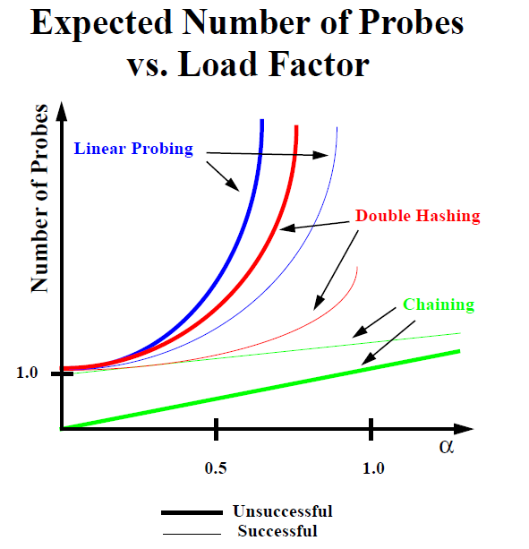
Hashing
Performance
Computer Science, Purdue University

Slide 15
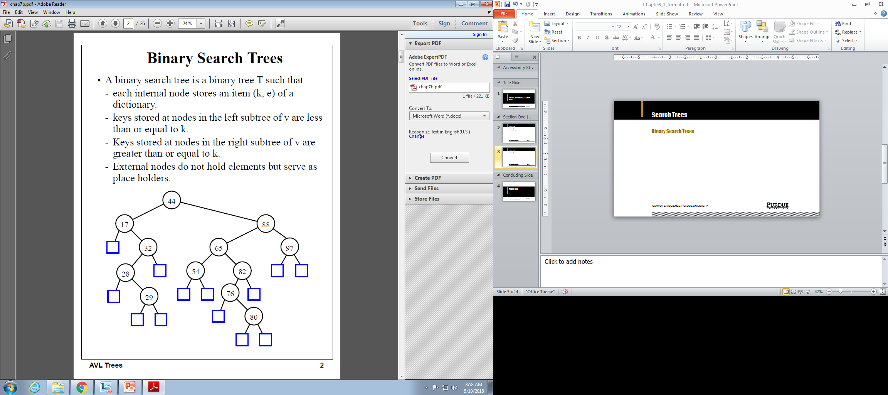
Search Trees
Binary Search Trees
Computer Science, Purdue University

Slide 16
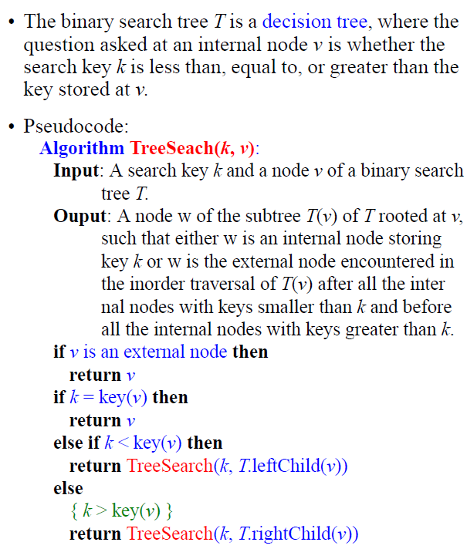
Search Trees
Binary Search Trees
Computer Science, Purdue University

Slide 17
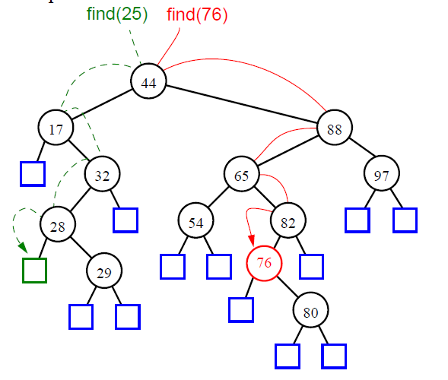
Search Trees
Binary Search Trees
Computer Science, Purdue University

Slide 18
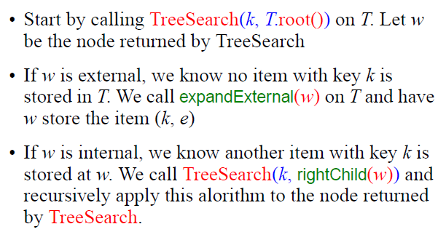
Search Trees
Binary Search Trees:
Insertion
Computer Science, Purdue University

Slide 19
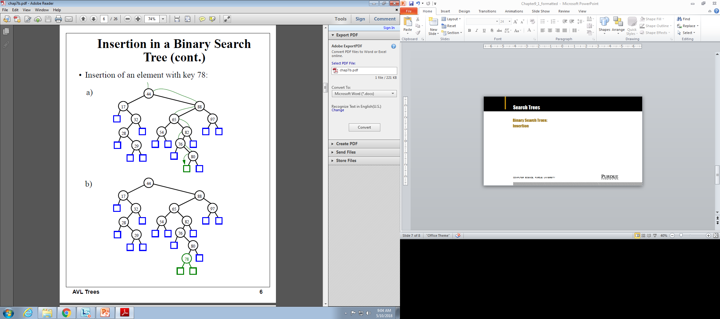
Search Trees
Binary Search Trees:
Insertion
Computer Science, Purdue University

Slide 20
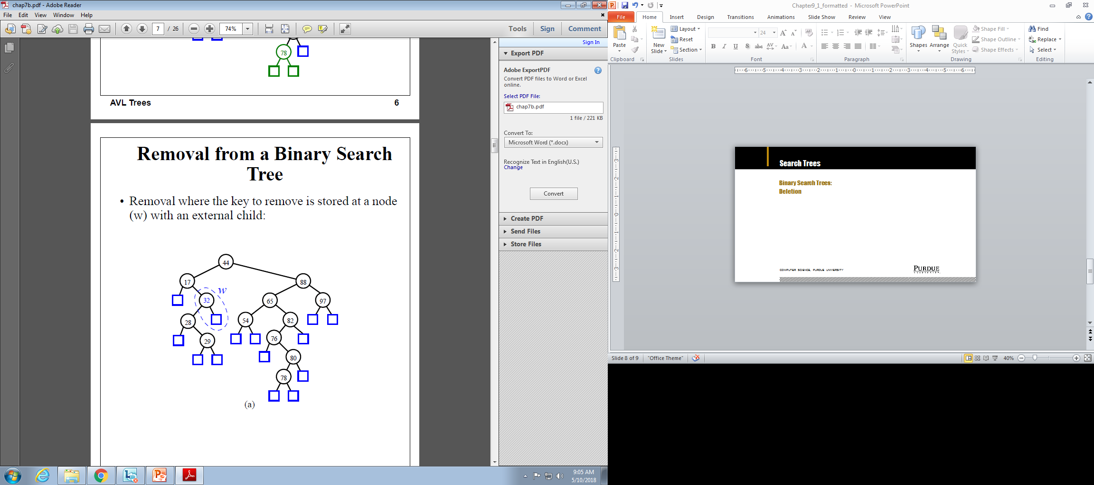

Search Trees
Binary Search Trees:
Deletion
Computer Science, Purdue University

Slide 21
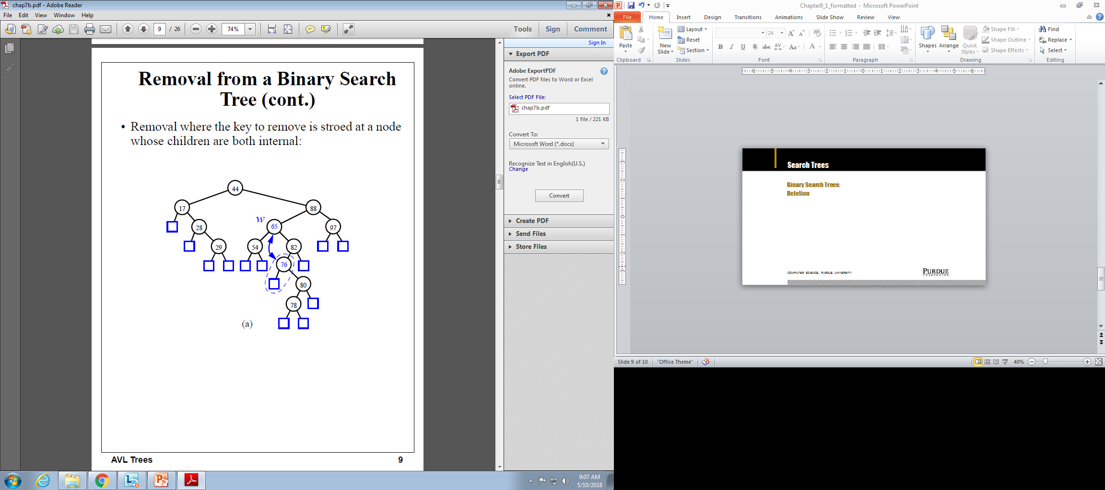
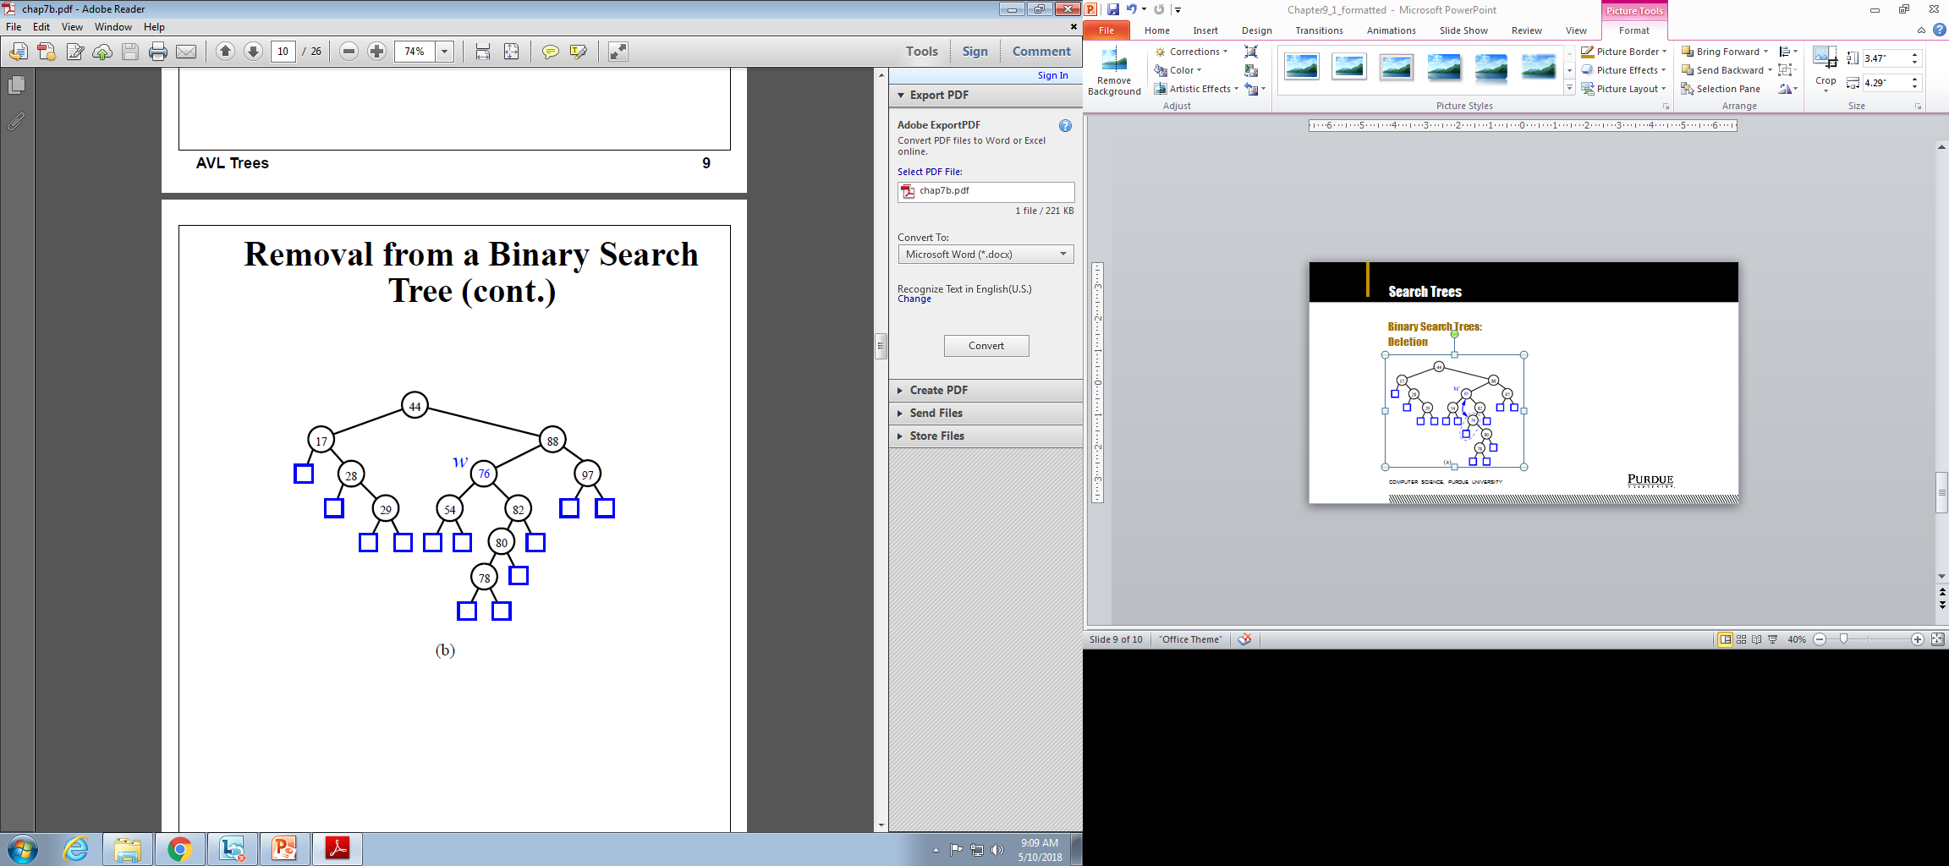
Search Trees
Binary Search Trees:
Deletion
Computer Science, Purdue University

Slide 22

Search Trees
Binary Search Trees: Time Complexity
Computer Science, Purdue University

Slide 23
Thank You

